Slide 1


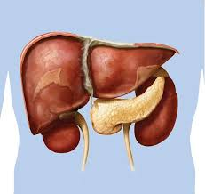





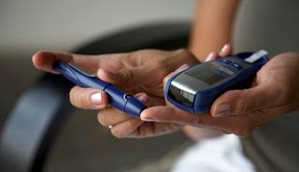

Benefits of Early Treatment Intensification
Overcome Clinical Inertia-Bend the curve in type-2 diabetes (T2DM)
AWA/Reassurance Slides/2023/July
NWADIOBI MICHAEL

Slide 2

Global Prevalence of Diabetes* Projected to More Than Double between 1995 and 2030
1995
2000
2030
Nations with highest projected prevalence in 2030 within their own region
130
135 million
552 million
120
110
100
India
90
80
United
States
70
China
Estimated Prevalence (millions)
60
Turkey
Pakistan
50
40
Nigeria
30
20
10
0
Africa
Americas
Eastern
Mediterranean
Europe
Southeast
Asia
Western
Pacific
*Type 2 diabetes mellitus represents ~90–95% of cases.
Adapted from World Health Organization. Country and regional dataIDF Diabetes Atlas 5th edition. www.idf.org/diabetesatlas/5e/ (Accessed March 2013). Regional estimates for the number of people aged 20‒79 years with diabetes, in millions.
. King H, et al. Diabetes Care. 1998; 21: 1414–1431.
Notes:
Global Prevalence of Diabetes* Projected to More Than Double between 1995
and 2030
The projections illustrated in this slide, based on World Health Organization data, are for the year 2030, when diabetes is predicted to affect ~366 million people – more than twice as many as in 1995, when 135 million patients had (documented) diabetes.^{1,2}
Individual sets of bars display estimates and projections by region. Although the prevalence of diabetes is expected to increase worldwide, the greatest increases are expected to be found in Southeast Asia, followed by western Pacific countries and the Americas.
Within each region, the 2030 projection (pink bar) displays a subdivision for the nation with the highest expected prevalence.
*Type 2 diabetes mellitus represents ~90–95% of cases
References
Wild S, et al. Global prevalence of diabetes: estimates for the year 2000 and projections for 2030. Diabetes Care. 2004; 27: 1047–1053.
King H, et al. Global burden of diabetes, 1995–2025: prevalence, numerical estimates, and projections. Diabetes Care. 1998; 21: 1414–1431.

Slide 3
WHO: Diagnostic Criteria
Plasma Venous Glucose Concentration
mmol/L
mg/dL
T2DM
Fasting*
or
2-h post-load glucose
or both
>7.0
>11.1
>126
>200
IGT
Fasting* (if measured) and
2-h post-load glucose
<7.0
>7.8 and <11.1
<126
>140 and <200
IFG
Fasting* and
(if measured) 2-h post-load glucose
>6.1 and <7.0
<7.8
>110 and <126
<140
IFG=impaired fasting glucose; IGT=impaired glucose tolerance; T2DM=type 2 diabetes mellitus; WHO=World Health Organization
*In asymptomatic patients, 2 abnormal fasting values are required for diagnosis.
Adapted from World Health Organization. Definition, Diagnosis and Classification of Diabetes Mellitus and Its Complications. Geneva: WHO;1999.
Notes:
WHO: Diagnostic Criteria
For the diagnosis of type 2 diabetes mellitus, the World Health Organization requires either a plasma venous glucose concentration ≥7.0 mmol/L (≥126 mg/dL) for fasting levels or ≥11.1 mmol/L (≥200 mg/dL) for levels 2 hours after a 75 g oral glucose load. Ideally, however, individual diagnoses should use both the fasting and 2-hour values.¹
The criteria add that in asymptomatic persons, a diagnosis of diabetes should not be based on a single abnormal blood glucose value; instead, at least one additional test on a separate day should result in the diabetic plasma glucose range.
Reference
World Health Organization. Diagnosis and classification of diabetes mellitus. In: Definition, Diagnosis and Classification of Diabetes Mellitus and Its Complications. Report of a WHO Consultation. Part 1. Geneva: World Health Organization; 1999: 1–59.

Slide 4
ADA Diagnostic Criteria and Treatment Goals for T2DM have been Evolving
Year
ADA Diagnostic Criteria
ADA Treatment Goal
1979¹
FPG >140 mg/dL
or
2-h PG (OGTT) >200 mg/dL
FPG <140 mg/dL
1997^{2,3}
FPG >126 mg/dL
or
2-h PG (OGTT) >200 mg/dL
HbA1c <7.0%
2006⁴
FPG >126 mg/dL
or
2-h PG (OGTT) >200 mg/dL
HbA1c <7.0% (general goal)
HbA1c <6.0% (individual goal)*
2008⁵
HbA1c = 7.0% is call for action
to initiate or change therapy
No new diagnostic
criteria mentioned
HbA1c <7.0%
ADA=American Diabetes Association; FPG=fasting plasma glucose; HbA1c=hemoglobin A1c; OGTT=oral glucose tolerance test; PG=plasma glucose;
T2DM=type 2 diabetes mellitus
*ADA asserted that the group treatment goal is <7.0%, but the individual treatment goal should be as close to normal (<6.0%) as possible without inducing significant
hypoglycemia (Diabetes Care. 2006; 29: S4–S42). ¹National Diabetes Data Group. Diabetes. 1979; 28: 1039–1057. ²American Diabetes Association. Diabetes Care.
1997; 20: 1183–1197. ³American Diabetes Association. Diabetes Care. 1997; 20 (Suppl 1): S5–S13. ⁴American Diabetes Association. Diabetes Care. 2006;
29 (Suppl 1): S43–S48; ⁵ Nathan DM, et al. Diabetes Care. 2009; 32:193–203.
Notes:
ADA: Diagnostic Criteria and Treatment Goals for T2DM have been Evolving
The American Diabetes Association (ADA) 2006 guidelines recommend the following criteria for the diagnosis of type 2 diabetes mellitus¹: patients must have either characteristic symptoms (eg, polyuria, polydipsia) plus a casual* plasma glucose level ≥11.1 mmol/L (≥200 mg/dL), or a fasting† plasma glucose level ≥7.0 mmol/L
(≥126 mg/dL), or a plasma glucose level ≥11.1 mmol/L (200 mg/dL) 2 hours after a
75 g oral glucose load.
Current ADA / European Association for the Study of Diabetes consensus guidelines do not mention new diagnostic criteria². The 2008 guidelines recommend HbA1c of 7.0% as a call for action to initiate or change treatment and HbA1c<7.0% as a treatment goal.²
*Casual is defined as measurement at any time, without regard to the amount of time since the last meal
†Fasting is defined as no caloric intake for at least 8 hours
References
American Diabetes Association. Standards of medical care in diabetes 2006. Diabetes Care. 2006; 29 (Suppl 1): S43–S48.
Nathan DM, et al. Medical management of hyperglycemia in type 2 diabetes: a consensus algorithm for the initiation and adjustment of therapy. Diabetes Care. 2009; 32:193–203.

Slide 5
Achievement of early glycaemic control comes with barriers particularly with common OAD’s like the Sulphonylureas

Slide 6





Targeting beyond glycaemia
Efficacy Barriers
Confused
Shaking
Feels hungry
Sweating
Feels weak
Diabesity: The new epidemic
Hypoglycaemia
Weight gain/obesity
Helping patients stick to their therapy!
Adherence to therapy
Sustainability

Slide 7


Convectional treatment approach in managing Type II Diabetes
Diet and
exercise
OAD
uptitration
OAD +
basal insulin
OAD + multiple daily insulin injections
10
OAD
monotherapy
OAD
combination
9
HbA_{1c}
(%)¹
8
7
Mean
6
Duration of diabetes
Complications²
¹Adapted from Del Prato S, et al. Int J Clin Pract 2005; 59:1345–1355.
²Stratton IM, et al. BMJ 2000; 321:405–412.
OAD = oral anti-diabetic
Notes:
Patients are not getting to the target glycemic goal because of inertia.

Slide 8

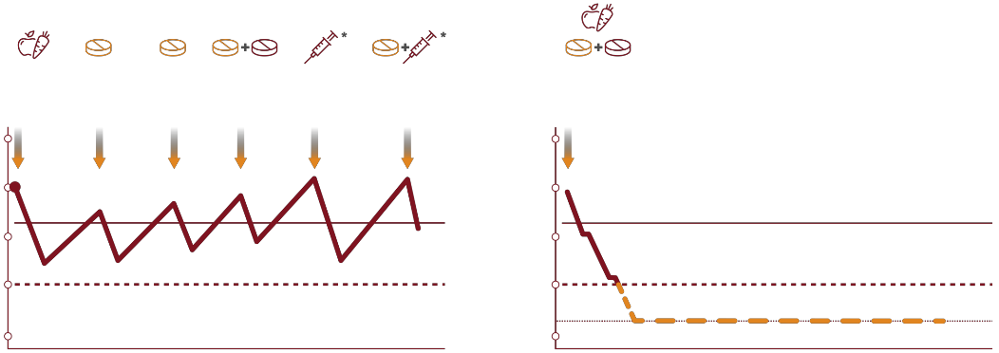
A new treatment approach to early T2DM?
1,2
Current stepwise approach
New approach: early OAD combination
10
10
HbA1c level
9
HbA1c level
9
8
8
7
7
6
6
T2DM duration
T2DM duration
OAD, oral antidiabetic agent; left diagram adapted from reference 2; right diagram is a theoretical representation of the potential impact of adding in earlier OAD combination to HbA1c levels (not representative of VERIFY study findings)
*injectable therapy

Slide 9
WHY THE NEED FOR
“GOOD LEGACY EFFECT”

Slide 10
Legacy effect: early glycaemic control is key to long-term reduction in complications
WITH GALVUS
YOU CAN OVERCOME
THE “EFFICACY BARRIERS”
ASSOCIATED WITH OTHER OADs
& ACHIEVE GOOD LEGACY
EFFECT
Good legacy effect
Early, strict glycaemic control brings benefits,
reducing the long-term risk of microvascular and macrovascular complications (UKPDS¹)
Bad legacy effect
Achieving glycaemic control late in the disease, after a prolonged period of poor control, does not improve long-term risk of macrovascular complications²
Long-standing, preceding hyperglycaemia accounted for
the high rate of complications at baseline in VADT³
UKPDS=UK Prospective Diabetes Study; VADT=Veterans Affairs Diabetes Trial.
¹Holman RR, et al. N Engl J Med. 2008; 359: 1577–1589.
²Duckworth W, et al. N Engl J Med. 2009; 360: 129–139;
³Del Prato S. Diabetologia. 2009; 52: 1219–1226.

Slide 11
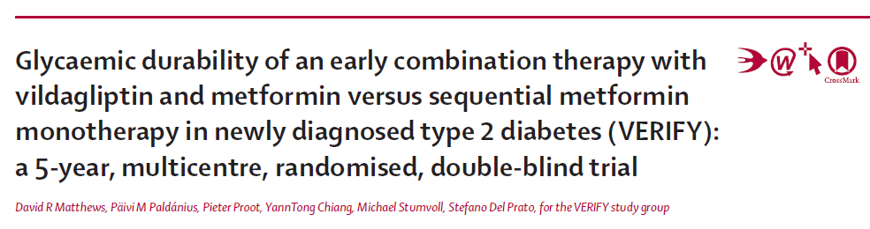
Vildagliptin Efficacy in Combination with
Metformin for Early Treatment of T2DM

Slide 12


A 5 year study in early T2DM comparing two treatment strategies^{1,9}
Baseline HbA1c: 6.5 – 7.5%
Newly-diagnosed Metformin run-in
5-year study
Period 1
Period 2
Period 3
MET 500 mg/d
MET 1000 mg/d
MET 1500 mg/d
Early combination strategy
Vilda 50 mg bid +
MET up to 1000 mg bid
Vilda 50 mg bid +
MET up to 1000 mg bid
+ (basal) insulin*
RANDOMIZATION
HbA1c ≥7.0% (twice)
At investigator discretion
Screening 2 weeks
Run-in 3 weeks
Placebo bid +
MET up to 1000 mg bid
Vilda 50 mg bid +
MET up to 1000 mg bid
+ (basal) insulin*
n~2001
Sequential metformin monotherapy strategy
Day 1
Visits every 3 months
5-Year Study
Primary endpoint: time to confirmed initial treatment failure (HbA1c ≥7%)
MET, metformin; Vilda, vildagliptin; bid, twice daily; *insulin initiation according to local guidelines

Slide 13




Strict glycemic control in the first year improves future T2DM outcomes⁸
Microvascular Macrovascular
Death

Slide 14

Strict glycemic control in the first year improves future T2DM outcomes⁸
Risk reduction from HbA1c levels <6.5% vs. between 7- 8% in first year, in a study with 13-year follow-up⁸
Microvascular Macrovascular Death
↓39%
p<0.0001
↓29%
p<0.0001
↓29%
p<0.001
HbA1c <6.5% (n=864); <7-8% (n=385); microvascular: end-stage renal disease, advanced eye disease, amputation; macrovascular: stroke, heart disease/failure, vascular disease

Slide 15
Key findings and clinical implications

Slide 16



Tight glycemic control maintained over 5 years in 40% of patients on vilda/met ¹⁰
VERIFY’ed: 40% vilda/met patients with 5 year glycemic levels below 6.5%
HbA1c<6.5%
at 5 years
28%
Patients on
met mono strategy*
40%
Patients on early
vilda/met strategy*
*Percentages given are best estimates from the graphical representation of the data in reference 9
28

Slide 17






Your early T2DM patients can enjoy better glycemic control
with an early combination strategy⁹
VERIFY’ed: 1 in 2 early T2DM patients are well controlled for at least 5 years
38%
Patients on met
mono strategy*
56%
Patients on early vilda/met strategy*
HbA1c <7%
at 5 years
p<0.001 vs. met mono
*Treatment success = HbA1c <7%; % patients shown derived from proportion of patients with HbA1c ≥7%
19

Slide 18

No increased risk of hypos despite low glycemic levels⁹
Hypoglycemic events by treatment arm
 | met mono (n=1001) | vilda/met (n=998)
Total number of hypoglycemic (hypo) events, n | 9 | 13
Grade 1 events | 100% | 100%
Low number
Mostly mild
383838

Slide 19

No weight gain over 5 years from baseline¹⁰
(average 1 kg reduction in both groups)
Difference in adjusted mean change, mean±SE: 0.26±0.35; p=0.289
Median body weight
At baseline:
85kg
85kg
At 5 years:
84kg
84kg
met mono
vilda/met
39

Slide 20

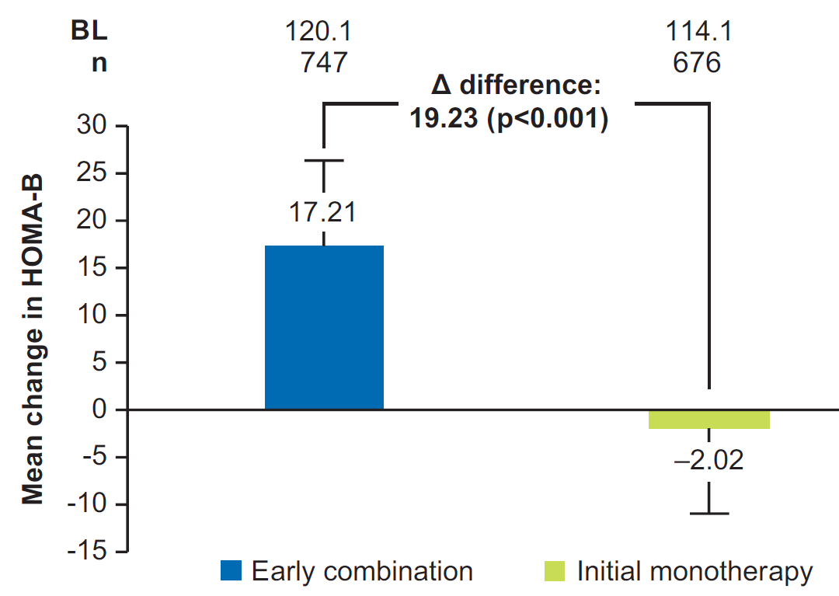
Early combination treatment showed improvement in fasting β-cell function compared with initial monotherapy
Early combination
Initial monotherapy
The mean (SD) change in HOMA-B from baseline to initial treatment failure was 17.21 (9.04) in the early combination group (baseline 120.1 [3.49]) and −2.02 (9.02) in the initial monotherapy group (baseline 114.1 [3.20]). The difference in adjusted mean change between the groups was 19.23 (95% CI: 8.42, 30.03; p<0.001)
The change in HOMA-B values were consistent with greater reductions in HbA1c in the early combination compared with initial monotherapy group
CI, confidence interval; EOS, end of study; HOMA-B, homeostasis model assessment for the β-cell; SD, standard deviation.
Paldánius PM et al. Poster presented at the European Association for the Study of Diabetes 2020 (PP609).

Slide 21
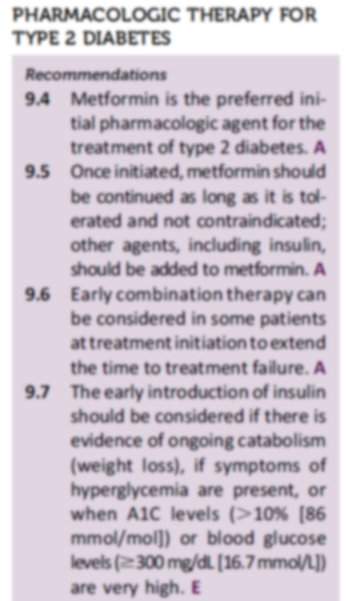
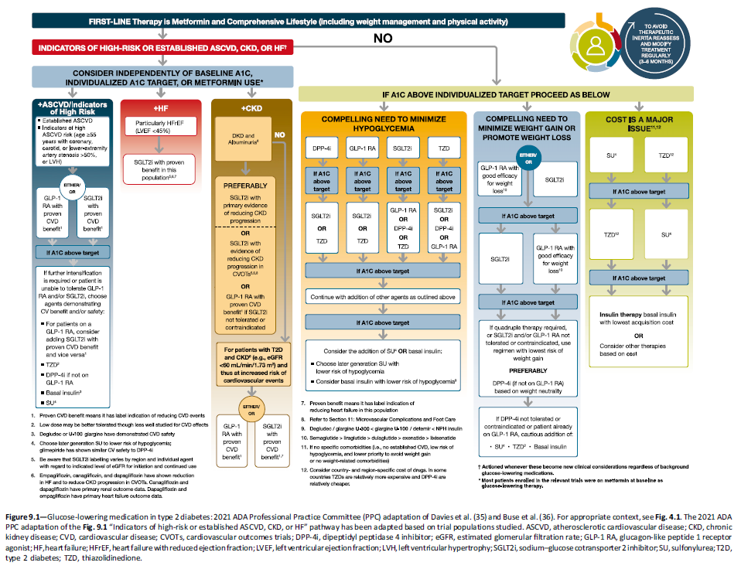
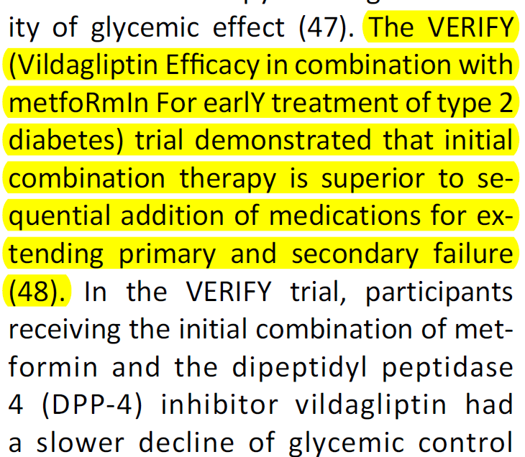
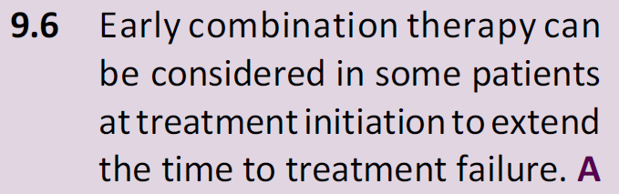
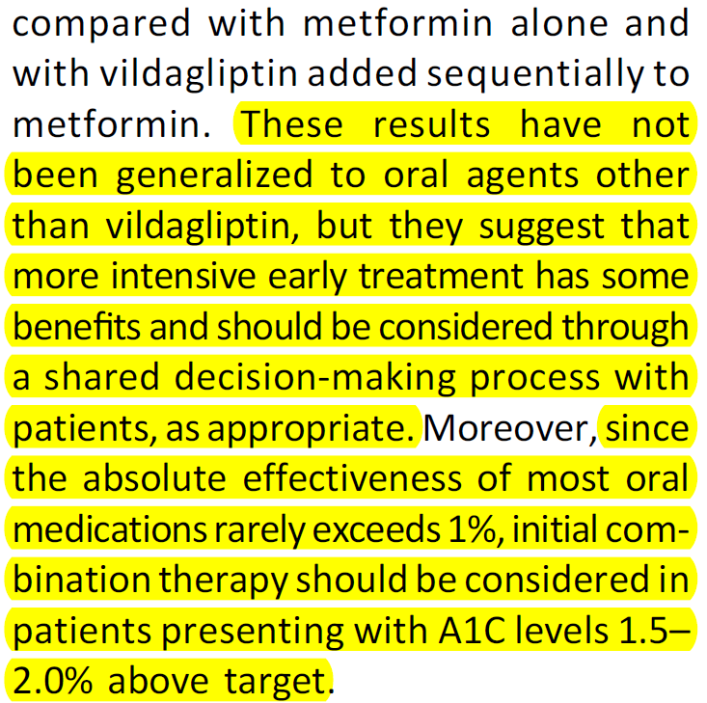
VERIFY results continue to drive change for optimizing patient care
2021
ADA 2021 current clinical practice guidelines recommends that early combination therapy can be considered in some patients versus sequential intensification^{3,4}
2020
ADA and EASD 2020 guidelines suggested that early combination therapy can be considered in some patients versus sequential intensification^{1,2}
1. Davies MJ et al. Diabetes Care 2018; 41(12):2669-701; 2. Buse JB et al. Diabetes Care. 2020;43(2):487-93; 3. ADA Diabetes Care 2020;43(Suppl 1):S98-110; 4. ADA Diabetes Care 2021;44(Suppl. 1):S15–S33.

Slide 22
Islet Enhancer Vildagliptin and DPP-4 Inhibition
GALVUS®

Slide 23
Inhibition of DPP-4 Increases Active GLP-1
Meal
Intestinal
GLP-1
release
GLP-1 t_{½}=1–2 min
Active
GLP-1
DPP-4
GLP-1
inactive
(>80% of pool)
DPP-4=dipeptidyl peptidase-4; GLP-1=glucagon-like peptide-1
Adapted from Rothenberg P, et al. Diabetes. 2000; 49 (Suppl 1): A39. Abstract 160-OR.
Adapted from Deacon CF, et al. Diabetes. 1995; 44: 1126–1131.
DPP-4
inhibitor
Notes:
Inhibition of DPP-4 Increases Active GLP-1
Released by intestinal L-cells in response to ingested food (upper left), glucagon-like peptide-1 (GLP-1) is rapidly and extensively inactivated (lower right).¹
The active amide is rapidly attacked at its N-terminus by dipeptidyl peptidase-4 (DPP-4), leaving the inactive metabolite GLP-1(9–36) and giving the active amide a half-life of only
1–2 minutes.²
Since DPP-4 is the only enzyme that can inactivate GLP-1, it was hypothesized that inhibition of DPP-4 may preserve intact (active) GLP-1 and improve metabolic control in treatment of type 2 diabetes mellitus.
In an early study with DPP-4 inhibitor NVP-DPP728, 12 healthy subjects fasted overnight and then ate a standardized breakfast 30 minutes after receiving single oral doses of placebo or the active drug.³
The active drug increased the subjects’ plasma levels of prandial active GLP-1, with concomitant reduction in prandial glucose exposure.
These findings, reported in 2000, were the first to provide direct evidence that inhibition of DPP-4 could be a viable pharmacologic approach for potentiating the activity of endogenous GLP-1 in humans.³
References
Kieffer TJ, et al. Degradation of glucose-dependent insulinotropic polypeptide and truncated glucagon-like peptide 1 in vitro and in vivo by dipeptidyl peptidase IV. Endocrinology. 1995; 136: 3585–3596.
Deacon CF, et al. Both subcutaneously and intravenously administered glucagon-like peptide 1 are rapidly degraded from the NH2-terminus in type II diabetic patients and in healthy subjects. Diabetes. 1995; 44: 1126–1131.
Rothenberg P, et al. Treatment with a DPP-IV inhibitor, NVP-DPP728, increases prandial intact GLP-1 levels and reduces glucose exposure in humans. Diabetes. 2000; 49 (Suppl 1): A39. Abstract 160-OR.

Slide 24

With GALVUS® – you can achieve the right HbA1c goals without the fear/risk of hypoglycaemia
and weight gain
With Galvus®
(Met + Galvus®)
Weight gain
and
hypoglycaemia
Body weight
HbA1c
Plasma glucose
HbA1c=haemoglobin A1c; OAD, oral antidiabetic drugs.
Jacob AN, et al. Diabetes Obes Metab. 2007; 9:386–393;
Kahn SE, et al. N Engl J Med. 2006; 355: 2427–2443;
Wright AD, et al. J Diabetes Complications. 2006; 20: 395–401.

Slide 25

Evidence of Efficacy without Efficacy Barriers with Galvus

Slide 26
Study design (EDGE study)
Multinational, multicenter, post-authorization, prospective, observational, cohort study
27 countries participated in five defined regions (East Asia, Europe, Latin America, Middle East and India)
A total of 45868 patients were enrolled in this study
Vildagliptin as add-on or vildagliptin/metformin (fixed-dose)*
Monotherapy failure
Comparator dual therapy OADs**
Month 0 1 2 3 4 5 6 7 8 9 10 11 12
BL demography
HbA1c
Weight
T2DM meds
HbA1c
Weight
T2DM meds
AEs, SAEs
HbA1c
Weight
T2DM meds
AEs, SAEs
REQUIRED OPTIONAL REQUIRED
DATA COLLECTION OPPORTUNITIES
  *Vildagliptin cohort: T2DM patients newly initiating vildagliptin as add-on dual therapy or newly initiating vildagliptin/metformin (fixed-dose) from non-vildagliptin monotherapy
  **Comparator OAD cohort: T2DM patients newly initiating therapy with oral anti-diabetic therapies other than vildagliptin (defined as SU, metformin, TZDs, metiglinides, α-glucosidase inhibitors) as add-on dual therapy except as add-on to vildagliptin, other DPP-4 inhibitors, or GLP-1 mimetics/analogues
  AE=Adverse event; BL=baseline; OAD=oral anti-diabetic drugs; T2DM=type 2 diabetes mellitus; TZDs=thiazolidinediones
C. Mathieu etal, Poster 863, Presented at the 48th European Association for the Study of Diabetes, 2012, 1-5th Oct, Berlin, Germany
S. Wangnoo, G. Bader, Poster 117-P, Presented at 1st American Diabetes Association Middle East, 2012, 4-6th Dec, Dubai, UAE
G. Bader, J.-B. Gruenberger, M. Kadwa, Poster 89-P, Presented at 1st American Diabetes Association Middle East, 2012, 4-6th Dec, Dubai, UAE

Slide 27
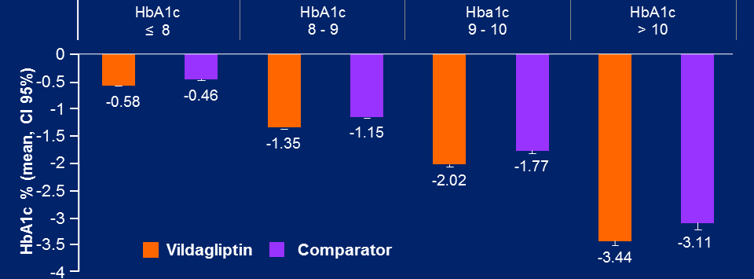
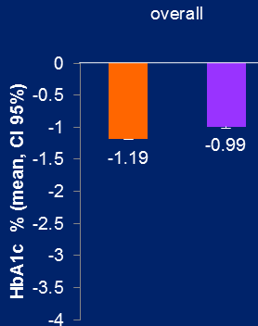
EDGE study: HbA1c reductions (by baseline HbA1c range) – higher A1c drops (-3.44) with higher baseline
Overall A_{1c} reductions
A_{1c} reductions by baseline
C. Mathieu etal, Poster 863, Presented at the 48th European Association for the Study of Diabetes, 2012, 1-5th Oct, Berlin, Germany
S. Wangnoo, G. Bader, Poster 117-P, Presented at 1st American Diabetes Association Middle East, 2012, 4-6th Dec, Dubai, UAE
G. Bader, J.-B. Gruenberger, M. Kadwa, Poster 89-P, Presented at 1st American Diabetes Association Middle East, 2012, 4-6th Dec, Dubai, UAE
Novartis data on file

Slide 28
Galvus: similar efficacy to glimepiride when added to metformin at 52 weeks (interim analysis) – no weight gain and low incidence of hypoglycaemia
Duration: 52 weeks
Add-on to metformin: vildagliptin vs glimepiride
Patients with
≥1 hypos (%)
Number of hypoglycaemic events
Severe events
(grade 2 and
suspected grade 2)
Add-on treatment to metformin (~1.9 g mean daily)
n=
1,389
1,383
1,389
1,383
1,389
Incidence (%)
No. of events
No. of events
1,383
Vildagliptin 50 mg twice daily + metformin
Mean HbA1c (%)
Glimepiride up to 6 mg once daily + metformin
NI: 97.5%
CI : 0.02, 0.16ª
–0.4%ª
–0.5%ª
Body weight (kg)
–8 –4 0 4 8 12 16 20 24 28 32 36 40 44 48 52 56
Time (weeks)
−1.8 kg
difference ª
Overall incidence of AEs was 74.5% and 81.1% in patients receiving vildagliptin and glimepiride, respectively
–8 –2 12 22 32 42 52
AE=adverse event; CI=confidence interval; HbA1c=haemoglobin A1c; NI=non-inferiority.
ªEndpoint values
HbA1c and body weight data from the per protocol population. Hypoglycaemia data from the safety population.
Ferrannini E, et al. Diabetes Obes Metab 2009;11:157–166; Data on file, Novartis Pharma AG.
Time (weeks)
Notes:
28

Slide 29
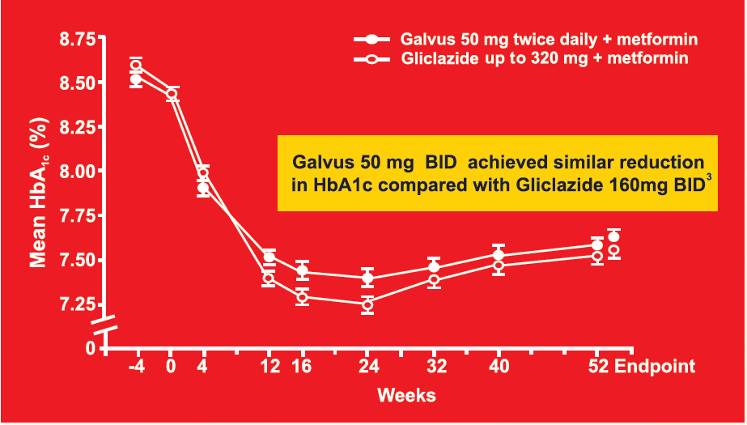
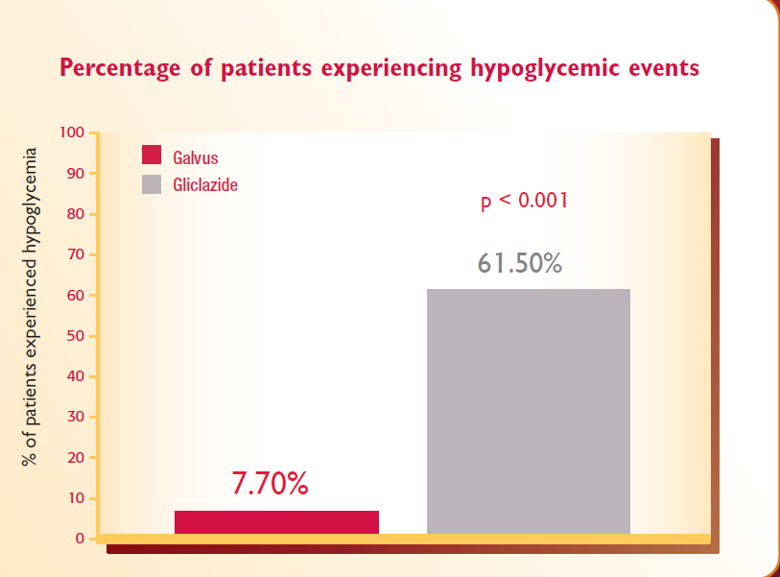
GALVUS-MET : Comparable efficacy versus Gliclazide plus Metformin with lower incidence of HYPOGLYCAEMIA

Slide 30

Key Take Away
Galvus give up to 3.44% reduction in HbA1c from a baseline of 10%.
Galvus’ offers efficacy you can see.
Galvus is not associated with the traditional efficacy barriers, such as hypoglycaemia and weight gain.
Galvus acts to preserve the beta cell function.
Inertia to Early intensification is much more reduced with GalvusMet, the starting dose is the final dose
C. Mathieu, Int J Clin Pract doi: 10.1111/ijcp.12252; W. A. Scherbaum et al, Diabetes, Obesity and Metabolism, 10, 2008, 1114–1124

Slide 31
Galvus/Galvusmet has shown benefits in;
Patient Group | Action | Benefits | Reference
Newly diagnosed >7.5% | Start Galvusmet BID | Up to 3.2% A1C reduction with >10% baseline | Bosi E, et al. Diabetes Care. 2009
Uncontrolled on Met | Switch Met to Galvusmet BID | 1.1% A1C reduction Up to 3.44% A1c reduction at base line>10% | Bosi E, et al. Diabetes Care. 2007
Uncontrolled on Met+SU | Switch Met to Galvusmet BID | 1.01% A1C reduction without relevant increase in weight and with a low incidence of hypoglycemia | Lukashevich V et al. Diabetes Obes Metab 2013
Uncontrolled on Insulin and or Insulin+ Met | Add Galvus/Switch Met to GalvusMet BID | 0.8% A1C reduction without relevant increases in hypoglycemia or weight | Kothny W et al, Diabetes Obes Metab 2012
Moderate, severe & ESRD T2D patient | Add on Galvus OD | 0.92% A1C reduction in severe 50% Cost saving vs other branded DPP4s | Lukashevich V et al. Diabetes Obes Metab 2011

Slide 32
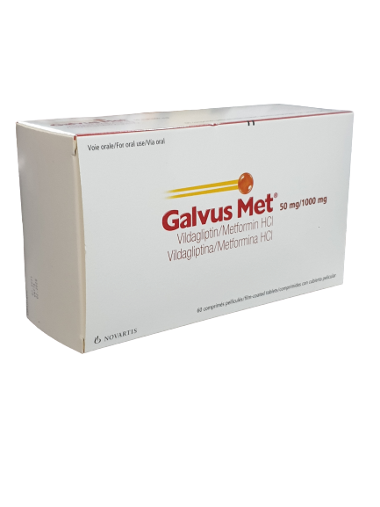
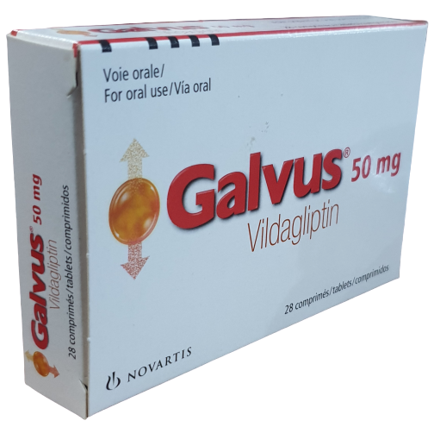
Galvus, Galvus Met
Available SKUs
Galvus 50mg
Galvus Met 50mg/500mg
Galvus Met 50mg/850mg
Galvus Met 50mg/1000mg

Slide 33
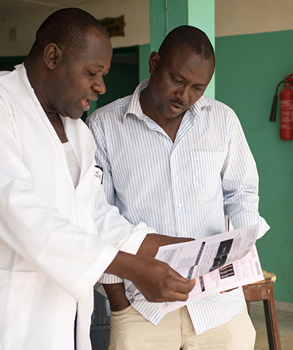

We all work together in order to ensure that our patients remain safe
Reasons to report Adverse Events:
• Adverse Event reports are important source for post-marketing data for ongoing evaluation of the safety of our products.
• Collection of Adverse Event related information can help to
prevent and secure the safety of your patients.
How do I report an Adverse Event?
Website | Email | Fax
www.novartis.com/report | patientsafety.westafrica@novartis.com | +221 33 859 45 15 (as back up only)

Slide 34


Galvus|Galvusmet - Verify Campaign: Feedback.

Slide 35
The consequences of hypoglycaemia
Hospitalization
costs⁴
Coma³
Cardiovascular
complications³
Death^{2,3}
Weight gain by
defensive eating⁵
Increased risk
of car accident¹
Hypoglycaemia
Loss of
consciousness³
Reduced
quality of life⁷
Increased risk
of dementia⁶
Increased risk
of seizures³
¹Begg IS et al. Can J Diabetes 2003;27:128–40 ²Bonds DE et al. BMJ 2010;340:b4909; ³Barnett AH. Curr Med Res Opin 2010;26:1333–42;
⁴Jönsson L et al. Value Health 2006;9:193–8; ⁵Foley JE et al. Vasc Health Risk Manag 2010;6:541–8; ⁶Whitmer RA et al. JAMA 2009;301:1565–72;
⁷McEwan P et al. Diabetes Obes Metab 2010;12:431–6
Notes:
Ten possible consequences of hypoglycaemia in patients with diabetes are listed in this slide, these include:
Increased risk of dementia¹
Death^{2,3}
Loss of consciousness³
Coma³
Increased risk of seizures³
Cardiovascular complications³
Costs incurred due to hospitalization⁴
Weight gain by defensive eating in order to prevent hypoglycaemia⁵
Increased risk of car accidents⁶
Reduced quality of life⁷
References:
Whitmer RA et al. JAMA 2009;301:1565–72
Bonds DE et al. BMJ 2010;340:b4909
Barnett AH. Curr Med Res Opin 2010;26:1333–42
Jönsson L et al. Value Health 2006;9:193–8
Foley JE et al. Vasc Health Risk Manag 2010;6:541–8
Begg IS et al. Can J Diabetes 2003;27:128–40
McEwan P et al. Diabetes Obes Metab 2010;12:431–6

Slide 36
Synergy between Galvus and Metformin on Prandial GLP-1
Effect of vildagliptin on prandial active GLP-1 levels in drug-naïve versus metformin-treated patients
Vildagliptin increases active GLP-1 levels by 2–4x through inhibition of the DPP-4 enzyme¹⁻⁴
Metformin raises GLP-1 levels, presumably by increasing GLP-1 synthesis and not through DPP-4 inhibition⁵⁻⁷
Vildagliptin and metformin are known to have synergy to maximize levels of intact GLP-1^{8,9}
*
Active GLP-1 AUC_{0–2h} (pmol/L)
Vildagliptin
in drug-naïve
patients(n=5)
Vildagliptin in
patients on
metformin (n=12)
AUC=area under the curve; DPP-4=dipeptidyl peptidase-4; GLP-1=glucagon-like peptide-1 *P <0.05.
¹Ahrén B, et al. J Clin Endocrinol Metab. 2004; 89: 2078–2084; ²Balas B, et al. J Clin Endocrinol Metab. 2007; 92: 1249–1255;
³Matikainen N, et al. Diabetologia. 2006; 49: 2049–2057; ⁴Rosenstock J, et al. Diabetes Care. 2008; 31: 30–35;
⁵Yasuda N, et al. Biochem Biophys Ref Commun. 2002; 298: 779–784; ⁶Hinke S, et al. Biochem Biophys Ref Commun. 2002; 291: 1302–1308;
⁷Migoya E, et al. Presented at EASD 2007; abstract 0111; ⁸Dunning B, et al. Presented at EASD 2006; abstract 0174; ⁹D’Alessio DA, et al.
J Clin Endocrinol Metab. 2009; 94: 81–88.
Notes:
36
Synergy between Vildagliptin and Metformin on Prandial GLP-1
Several studies have shown that the dipeptidase peptidyl-4 (DPP-4) inhibitor vildagliptin leads to a
2- to 4-fold increase of active incretin hormones glucagon-like peptide-1 (GLP-1) and glucose-dependent insulinotropic polypeptide (GIP).¹⁻⁴ Interestingly, other studies document that metformin increases GLP-1 levels in patients with type 2 diabetes mellitus (T2DM) through a mechanism independent of DPP-4 inhibition, presumably by augmenting the synthesis of GLP-1. These findings would suggest that the combination of metformin with a DPP-4 inhibitor would be useful for the treatment of T2DM.^{5,6}
The data presented in the graph are derived from a mechanistic double-blind, placebo-controlled study in patients with T2DM. Incretin hormone levels (GLP-1, GIP) were measured after 6 weeks of treatment with vildagliptin 50 mg twice daily or placebo. Vildagliptin increased postprandial levels of the active GLP-1 and GIP, but the increase of postprandial GLP-1 was significantly greater in the metformin-treated than the drug-naïve subgroup.^{7,8} Similar data were also shown with other DPP-4 inhibitors.⁹
The analysis shows that DPP-4 inhibition with vildagliptin has a greater effect on active GLP-1 in patients receiving concomitant metformin than in drug-naïve patients, suggesting a synergy between vildagliptin and metformin to maximize levels of active GLP-1. This finding may underlie the particularly pronounced efficacy of vildagliptin to reduce HbA1c, fasting plasma glucose, and postprandial glucose when added to patients with T2DM inadequately controlled on metformin alone.^{10,11}
References
1. Balas B, et al. J Clin Endocrinol Metab. 2007; 92: 1249–1255.
2. Ahrén B, et al. J Clin Endocrinol Metab. 2004; 89: 2078–2084.
3. Rosenstock J, et al. Diabetes Care. 2008; 31: 30–35.
4. Matikainen N, et al. Diabetologia. 2006; 49: 2049–2057.
5. Hinke S, et al. Biochem Biophys Ref Commun. 2002; 291; 1302–1308.
6. Yasuda N, et al. Biochem Biophys Ref Commun. 2002; 298: 779–784.
Dunning B, et al. Presented at EASD 2006; abstract 0174.
D’Alessio DA, et al. J Clin Endocrinol Metab. 2009: 94: 81–88.
Migoya E, et al. Presented at EASD 2007; abstract 0111.
Bosi E, et al. Diabetes Care. 2007; 30: 890–895.
Ahrén B, et al. Diabetes Care. 2005; 28: 1936–1940.

Slide 37

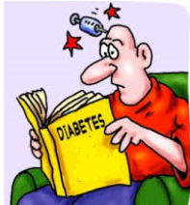
Defining simplicity in diabetes management
Addresses
pathophysiology
A1c lowering
Sugar
control
Easy to take
Safety
Side effects
Hypos
Weight
Ease of
administration
Special
populations
Weight/
hypos

Slide 38
Clinical problem in management of type 2 diabetes
Clinical inertia:
The failure to intensify treatment leads to progressive ꞵ-cell deterioration and clinical complications
9.5
9.0
8.5
8.0
Generation of a ‘bad glycaemic legacy’ drives risk of complications
HbA1c (%)
7.5
7.0
6.5
Ideal HbA1c
6.0
1
2
3
4
5
6
7
8
9
10
11
12
13
14
15
16
17
Time since diagnosis (years)
Do those with type 2 diabetes benefit from having combined therapy at the beginning of their pharmacological treatment?
Q
Do those with type 2 diabetes benefit more from having combined therapy at the beginning of their pharmacological treatment compared to a sequential additive strategy?
Adapted from Del Prato S. Diabetologia.2009;52:1219-1226.

Slide 39
Progressive β-cell Failure in Type 2 Diabetes
100
Diagnosis
80
60
β-cell Function
(% β)
40
20
0
-12
-6
0
6
12
Years
Based on data of UKPDS 16: conventional (diet) treatment group. Diabetes. 1995.

Slide 40


Traditional Current Oral Therapies Do Not Address Islet Cell Dysfunction
Insulin Resistance
(Impaired insulin action)
Pancreatic Islet Dysfunction
Inadequate
glucagon
suppression
(α-cell
dysfunction)
Insufficient Insulin secretion
(β-cell
dysfunction)
Progressive
decline of β-cell function
Metformin
TZDs
Sulfonylureas
Glinides
TZD=thiazolidinedione
Adapted from DeFronzo RA. Br J Diabetes Vasc Dis. 2003; 3 (Suppl 1): S24–S40.
Notes:
Traditional Current Oral Therapies Do Not Address Pancreatic Islet Cell Dysfunction
The pathophysiologic hallmarks of type 2 diabetes mellitus (T2DM) are insulin resistance, pancreatic islet dysfunction (α- and β-cell dysfunction), and excessive hepatic glucose production.¹ Current oral antidiabetic drugs (OADs) address various aspects of these defects, focusing heavily on insulin resistance and glucose control.²
There remain unmet needs in the treatment armamentarium of T2DM, particularly with regard to pancreatic islet dysfunction.
No currently available traditional OADs address α-cell dysfunction and the resulting inadequate suppression of glucagon, which leads to increased hepatic glucose production.
While the insulin secretagogues are used to treat insufficient insulin secretion
(β-cell dysfunction), no oral agents to date address the more progressive β-cell decline.
References
Moneva MH, Dagogo-Jack S. Multiple drug targets in the management of type 2 diabetes. Curr Drug Targets. 2002; 3: 203–221.
DeFronzo RA. Impaired glucose tolerance: do pharmacological therapies correct the underlying metabolic disturbance? Br J Diabetes Vasc Dis. 2003; 3 (Suppl 1): S24–S40.

Slide 41

What if you could offer your early T2DM patients a
new approach to their treatment ?^{1,2}

Slide 42

Adverse event (AE) profiles similar for both treatment arms⁹
VERIFY: AE profiles by treatment arm
83.2%
83.5%
met mono (n=1,003)
vilda/met (n=998)
18.3%
16.6%
0.9%
1.3%
Patients with ≥1 AE
All serious AEs
Death*
*None of these cases were considered to be related to the study medications
37

Slide 43
VERIFY - Key findings
Early combination treatment strategy of vildagliptin plus metformin was superior to standard of care metformin monotherapy
  Significantly reduces the risk of time to initial treatment failure by 49% vs. initial monotherapy strategy
  Significantly reduces the risk of time to second treatment failure by 26% vs. sequential additive strategy
Early combination treatment strategy of vildagliptin plus metformin confers a robust and durable HbA1c reduction and is weight neutral
The benefits of early combination treatment strategy of vildagliptin plus metformin are consistent in all patient populations
The early combination treatment strategy of vildagliptin plus metformin is safe and well-tolerated
Matthews DR et al. Lancet. 2019;394:1519-29.

Slide 44
VERIFY - clinical relevance
The strategy of an early combination treatment approach with vildagliptin plus metformin in patients with newly diagnosed type 2 diabetes significantly and consistently improves long-term glycaemic durability compared with metformin monotherapy
Matthews DR et al. Lancet. 2019;394:1519-29.

Slide 45
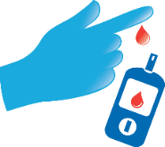

What does VERIFY study tell us about glycaemic durability?
With having combined therapy at the beginning of pharmacological treatment in patients with T2D, it is possible to ensure earlier and better glycaemic control
that may be more durable
with low risk of hypoglycemia and no gain in body weight
perhaps improving patients’ adherence to treatment
possibly reducing clinical inertia
offering more opportunities to address individual patient needs’
Durability of glycaemic control

Slide 46
10.1 The societal impact of early intensified treatment in patients with T2DM (Mexico)*
New
*The study is based on VERIFY trial.

Slide 47


Measuring the health and socioeconomic impact of early intensified antidiabetic therapy in Mexico
Diabetes caused at least USD 966 billion dollars in health expenditure – 9% of total spending on adults¹
Substantial economic loss is associated with diabetes and its complications to patients, families and the healthcare system through direct (direct and indirect medical costs) and indirect costs (productivity losses)
Recent short-term studies have highlighted the importance of achieving early glycaemic control within the first year of diagnosis, as this improves long-term glycaemic durability and reduces the risk of complications²
VERIFY provided the most compelling evidence accumulated for over 5 years to guide treatment optimisation in T2DM demonstrating the potential of early combination therapy with vildagliptin–metformin versus metformin alone³
GMA, Global Health/Access and WifOR institute collaborated to highlight the long-term effects of early intensified treatment on health outcomes (i.e., complication events) and the associated societal impact³
T2DM, type 2 diabetes mellitus.
1. International Diabetes Federation. IDF Diabetes Atlas, 10th edn. Brussels, Belgium: International Diabetes Federation, 2021;
2. Laiteerapong N, et al. Diabetes Care. 2019;42:416–426; 3. Matthews DR, et al. Lancet. 2019;394(10208):1519–1529;
3. Tsotra F, et al. J. Comp Eff Res. 2022. DOI: https://doi.org/10.2217/cer-2022-0110 (Epub ahead of print).

Slide 48
General model settings
Target Population: Patients with T2DM in Mexico, who are diagnosed, currently treated and aged between 20 and 70 years
Modeling Scenario: Comparing the time to 1st and 2nd treatment failure between early intensified antidiabetic treatment and a stepwise approach of antidiabetic treatment.
Model Structure: Markov-Model, transition probabilities are derived from a survival analysis based on VERIFY data
Complication events: Stroke, MI, HF, neuropathy, nephropathy. Event probabilities are derived from the VERIFY data and also literature
Productivity and Activity Impairment: Event-specific rate of return to work, absenteeism, presenteeism and activity restriction, derived from secondary literature
Monetization: Average hourly wage at PPP (USD 7.85) for paid work and average minimum wage at PPP for unpaid activities (USD 1.24)
Time Horizon: 10 years (cycle length of 6 month)
HF, heart failure; MI, myocardial infarction; PPP, purchasing power parity; T2DM, type 2 diabetes mellitus
Tsotra F, et al. J. Comp Eff Res. 2022. DOI: https://doi.org/10.2217/cer-2022-0110 (Epub ahead of print).

Slide 49
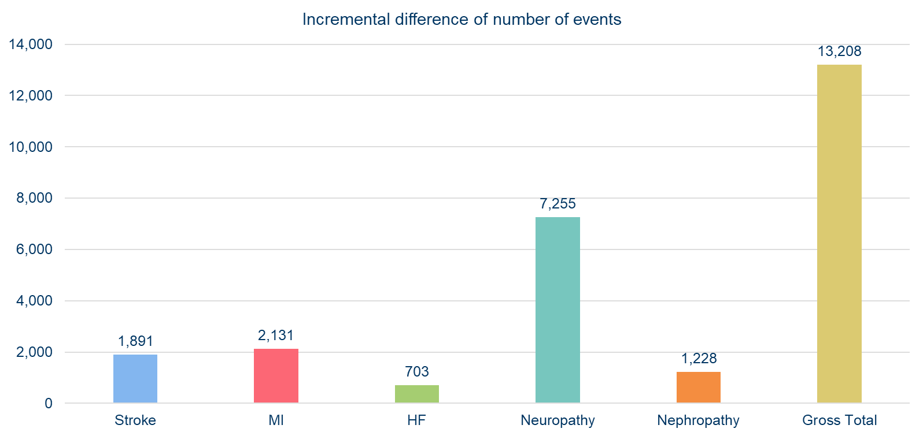
Approximately 13,000 complication events can be avoided with early intensified treatment over a period of 10 years
Tsotra F, et al. J. Comp Eff Res. 2022. DOI: https://doi.org/10.2217/cer-2022-0110 (Epub ahead of print).

Slide 50
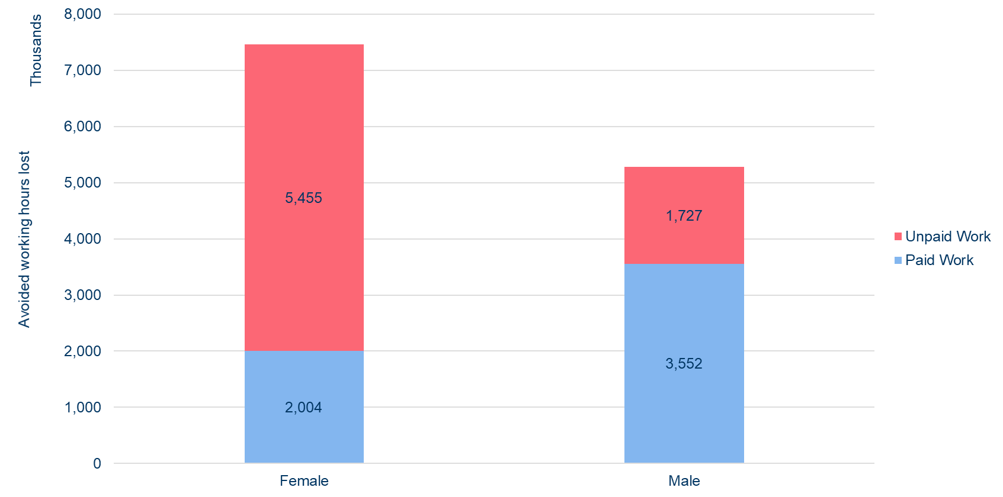
A loss of ~13 million paid and unpaid working hours can be avoided by early intensified treatment over a period of 10 years
Tsotra F, et al. J. Comp Eff Res. 2022. DOI: https://doi.org/10.2217/cer-2022-0110 (Epub ahead of print).

Slide 51
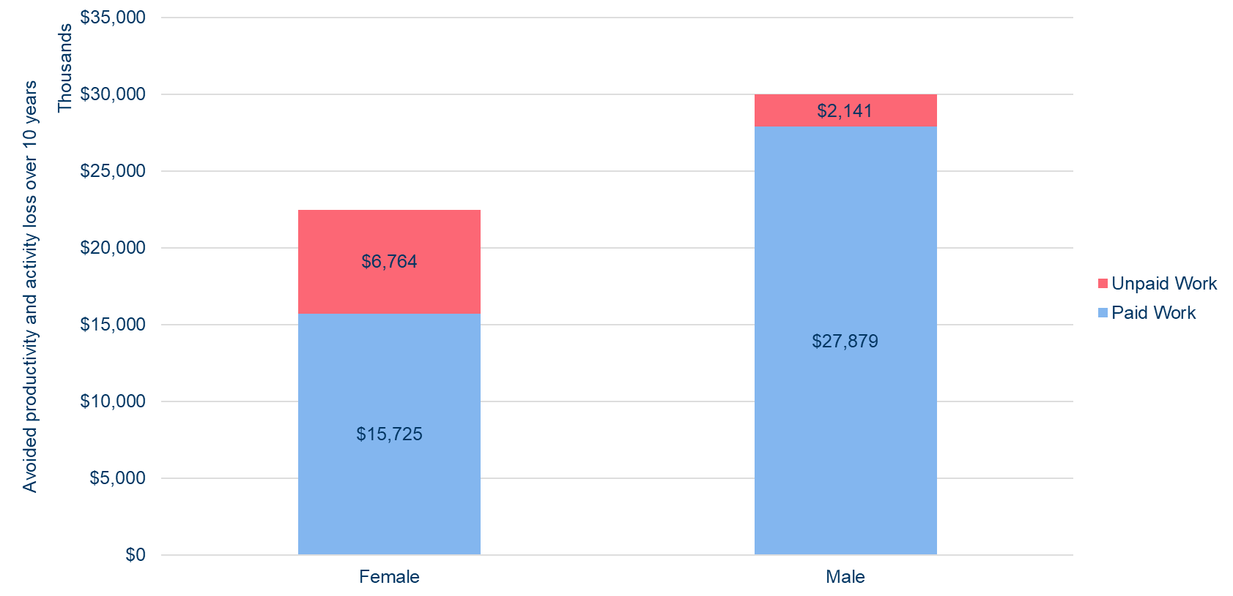
Total societal impact of early intensified antidiabetic treatment in terms of avoided productivity and activity losses amounts to
~USD 53 million in 10 years
Tsotra F, et al. J. Comp Eff Res. 2022. DOI: https://doi.org/10.2217/cer-2022-0110 (Epub ahead of print).

Slide 52
The early and intensified treatment of T2DM is estimated to have a substantial impact on Mexican society
A hypothetical cohort of 505,798 patients receives early intensified antidiabetic treatment, 55% are women and 45% are men
Due to delayed disease progression 13,208 complication events are potentially avoided by early intensified antidiabetic treatment over a period of 10 years
The avoidance of complication events translates into 12,737,851 avoided paid and unpaid hours lost
Female patients account for 7,458,639 avoided hours lost, 73% are attributable to activity impairment, i.e., unpaid working hours
Male patients account for 5,279,211 avoided hours lost, 67% are attributable to productivity impairment, i.e., paid working hours
The societal impact of early intensified antidiabetic treatment in terms of avoided productivity and activity losses amounts to USD 52,509,234 in 10 years, 83% of the impact is due to avoided productivity losses
T2DM, type 2 diabetes mellitus.
Tsotra F, et al. J. Comp Eff Res. 2022. DOI: https://doi.org/10.2217/cer-2022-0110 (Epub ahead of print).

Slide 53

Galvus Add-on to Metformin: Effective HbA1c Reduction at 24 Weeks
Duration: 24 weeks
Vilda add-on to met
Add-on Treatment to Metformin (2.1 g Mean Daily)
Mean Difference vs PBO
BL ~8.4%
Change in HbA1c (%)
-0.7
*
*
Vilda 50 mg once daily + met (n=143)
BL=baseline; HbA1c=hemoglobin A1c; met=metformin;
PBO=placebo; vilda=vildagliptin.
Primary intention-to-treat population.
*P <0.001 difference vs PBO.
Bosi E, et al. Diabetes Care. 2007; 30: 890–895.
Vilda 50 mg twice daily + met (n=143)
Notes:
Vildagliptin Add-on to Metformin: Effective HbA1c Reduction at 24 Weeks
This 24-week, double-blind, randomized, multicenter, placebo-controlled study compared the effects of treatment with vildagliptin 50 mg once daily (n=143), vildagliptin 50 mg twice daily (n=143), or placebo (n=130) in patients with type 2 diabetes mellitus (T2DM) continuing a stable metformin dose regimen (mean dose 2.1 g daily) but achieving inadequate glycemic control (HbA1c 7.5–11%).¹
Eligible patients had received metformin monotherapy treatment for at least
3 months and had been on a stable dose of metformin (≥1500 mg daily) for at least 4 weeks.
Treatment with vildagliptin as an add-on to metformin led to a significant dose-related decrease in HbA1c compared with placebo plus metformin.
The between-treatment difference (ie, vildagliptin – placebo) in adjusted mean change in HbA1c from baseline to end point was −0.7 ± 0.1% (P <0.001) with vildagliptin 50 mg once daily and −1.1 ± 0.1% (P <0.001) with vildagliptin 50 mg twice daily.
These results demonstrate that vildagliptin produces clinically meaningful, dose-related decreases in HbA1c levels at 24 weeks as add-on therapy in patients with T2DM inadequately controlled by metformin.
Reference
Bosi E, et al. Effects of vildagliptin on glucose control over 24 weeks in patients with type 2 diabetes inadequately controlled with metformin. Diabetes Care. 2007; 30: 890–895.
53

Slide 54
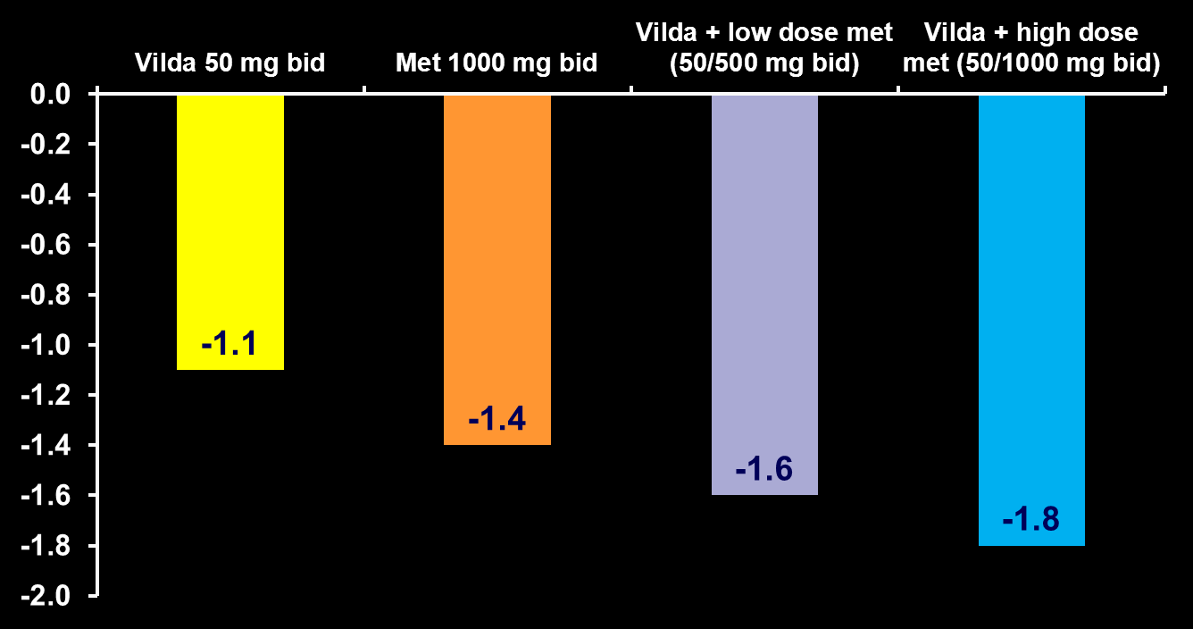
Galvus plus metformin initial combination therapy
n=287
n=285
n=277
n=285
Mean change in HbA1c (%)
P <0.001
P =0.004
P <0.001
P <0.001
HbA1c change from baseline to Week 24; mean baseline HbA1c ~8.6 %
Intent-to-treat population (HbA1c); Safety population (adverse events [AEs]). AEs were experienced by 51.5, 59.9, 55.9 and 57.5% of patients receiving vildagliptin monotherapy [n=297], metformin monotherapy [n=292], vildagliptin + low-dose metformin [n=290] and vildagliptin + high-dose metformin [n=292], respectively. Bosi E, et al. Diabetes Obes Metab 2009;11:506–15
Countries where initial combination of vildagliptin and metformin therapy is approved with a new indication: Argentina, Aruba, Bangladesh, Brazil, Curacao, Dominican Republic, Ecuador, El Salvador, Ghana, Guatemala, Honduras, Hong Kong, Jordan, Kenya, Korea, Mexico, Morocco, Nigeria, Pakistan, Philippines, Russia, Saudi Arabia, Singapore, Sudan. Countries where initial combination of vildagliptin and metformin therapy is approved without a new indication: Egypt, EU, Indonesia.

Slide 55
Association between change in HbA1c and baseline HbA1c: comparison between RCTs and real-world data (EDGE)
Metformin + SU
Metformin + Galvus
RCT
EDGE
0.0
Δ=0.41%
0.0
Δ=0.06%
Interaction coefficient:
–0.327 (P<0.001)
Interaction coefficient:
0.024 (P=NS)
–0.5
–0.5
Change in HbA1c at 24 weeks (%)
Change in HbA1c at 24 weeks (%)
–1.0
–1.0
–1.5
–1.5
Δ=0.22%
Δ=0.04%
–2.0
–2.0
6.0
6.5
7.0
7.5
8.0
8.5
9.0
9.5
10.0
6.0
6.5
7.0
7.5
8.0
8.5
9.0
9.5
10.0
Baseline HbA_{1c} (%)
Baseline HbA_{1c} (%)
With vildagliptin as add-on to metformin, the association between HbA1c reduction and baseline HbA1c under real-life conditions appeared to be consistent with the RCTs
Pooled data from 5 randomized controlled trials [RCTs] in 4,480 patients (N=2,788 vildagliptin; N=1,692 sulphonylureas [SUs]) compared with data from the EDGE study (N=7,002 vildagliptin; N=3,702 SUs)
Ahrén et al. Diabetologia 2014;57:1304–7
Notes:
This post-hoc analysis pooled data from five randomized clinical trials (RCTs) conducted in 4,480 patients (vildagliptin N=2,788; sulphonylureas [SUs] N=1,692 [glimepiride: n=1,259; gliclazide: n=433)]) and compared with a large sample of patients extracted from the Effectiveness of Diabetes control with vildaGliptin and vildagliptin/mEtformin (EDGE) study (vildagliptin, N=7,002; SUs, N=3,702).
The impact of baseline haemoglobin A1c (HbA1c), age, gender and weight on change in HbA1c after 24 weeks were assessed by linear regression model. Overall, 36% of the change in HbA1c was correlated to baseline HbA1c [slope -0.54 (95% confidence interval [CI]: -0.55, -0.53; P<0.0001)], while age, gender and baseline weight were poorly correlated.
The data presented on this slide shows change in HbA1c as a function of baseline HbA1c with SUs (left-hand side) or vildagliptin (right-hand side) as add-on to metformin. With SU, the slope was −0.541 (95% CI −0.56, −0.52; P<0.001) in RCTs, but was steeper under real-life conditions (in EDGE, interaction coefficient was −0.327, P<0.001). As such, for any given baseline HbA1c, in RCTs the change in HbA1c with SU treatment is greater than in real life. In contrast, the regression lines for vildagliptin were nearly superimposable in EDGE and the RCT populations; the slope of the regression line was −0.55 (95% CI−0.56, −0.53; P<0.001) and there was no interaction with study conditions (RCT vs EDGE, coefficient was 0.024, P=0.175).
Overall, this study showed that the reduction in HbA1c with SU treatment was diminished in real life relative to RCTs, whereas for vildagliptin, the improvement in glycaemia was the same in RCTs and the observational trial.
Reference
Ahrén et al. Diabetologia 2014;57:1304–7.

Slide 56


Real-life data
Global results of
Effectiveness of Diabetes control with vildaGliptin and vildagliptin/mEtformin
Mathieu et al. Int J Clin Pract. 2013 Oct;67(10):947-56. doi: 10.1111/ijcp.12252.

Slide 57
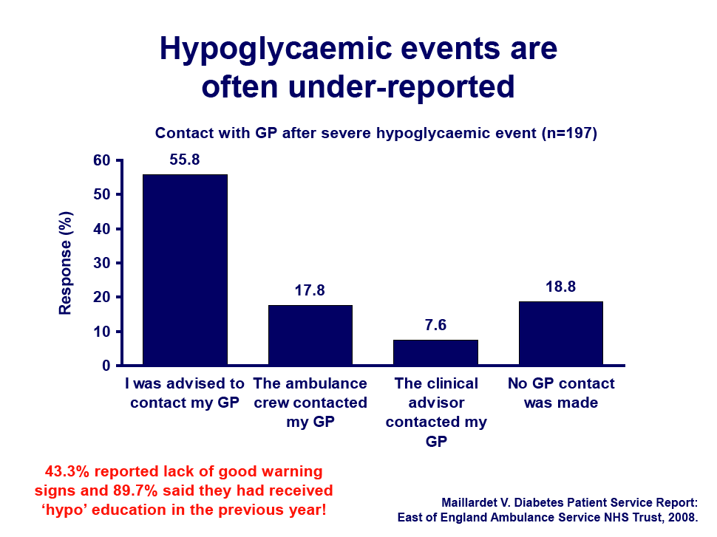

Slide 58
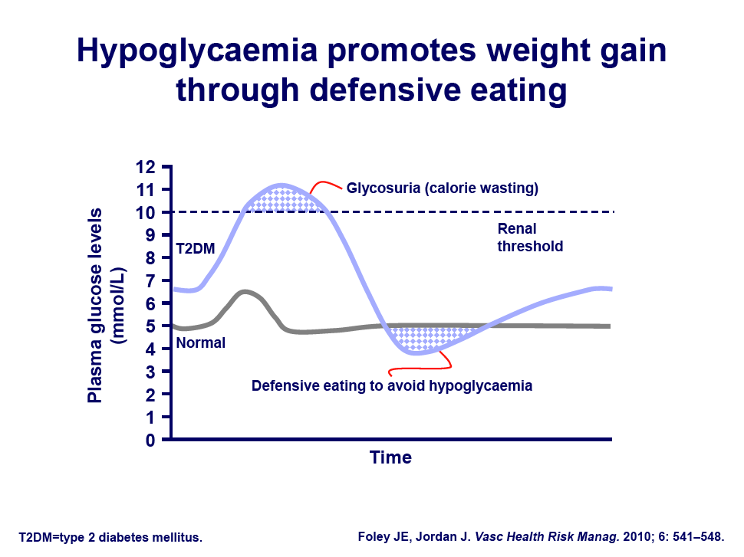

Slide 59
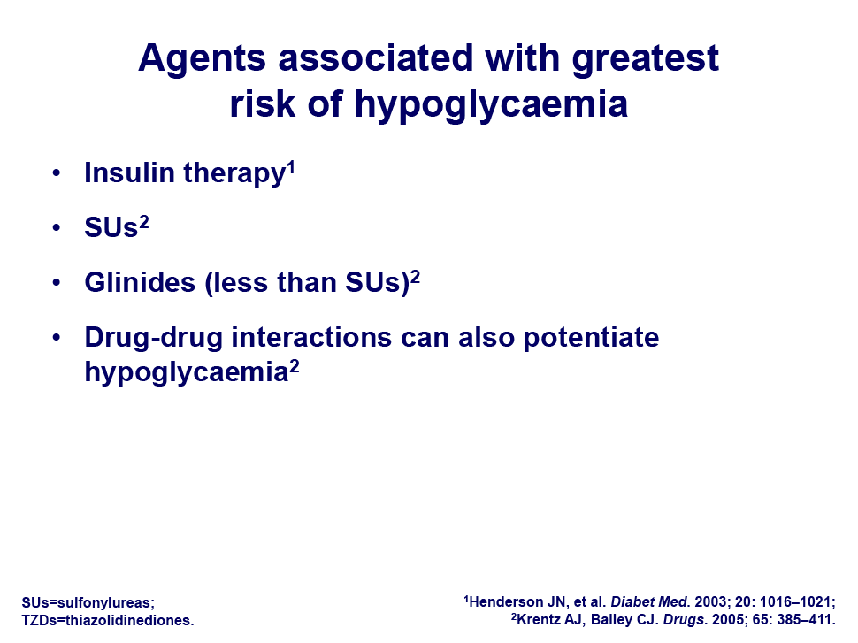

Slide 60





Achieving efficacy without barriers in T2DM patients on insulin therapy

Slide 61
Objective and study design
Objective: To assess the efficacy and tolerability of vildagliptin added to insulin therapy in patients with type 2 diabetes mellitus.
Target population: Patients with type 2 diabetes mellitus inadequately controlled (HbA1c: 7.5–11%) by insulin therapy.
Screening period
Double blind treatment period
Vildagliptin 50 mg bid + insulin n=144
N=461
Placebo + insulin n=152
4 weeks
Randomization
24 weeks
Patients that were eligible received only injectable insulin for at least 3 months, at a dose of at least 30 U/day for a minimum of 4 weeks prior to enrolment. Investigators were allowed to decrease a patient’s insulin dose according to their clinical judgment in the event of severe or repeated hypoglycemic episodes. Upward dose adjustments were allowed as clinically indicated, but were recommended to remain within 25% of the baseline insulin dose.
bid, twice daily
Adapted from: Fonseca V et al. Diabetologia. 2007;50:1148–55.

Slide 62
Galvus as add-on to insulin: significant HbA1c reduction in patients uncontrolled on insulin
Mean (±SE) changes in HbA1c over 24 weeks
Adjusted mean (±SE) change in HbA1c from baseline to week 24
9.0
BL (%)
8.4±0.1
8.3±0.1
8.5
8.0
Mean HbA1c (%)
7.5
0.0
-8
-4
0
4
8
12
16
20
24
Time (weeks)
Vildagliptin 50 mg bid
Placebo
Between-treatment difference
*p=0.010
bid, twice daily; BL, baseline; SE, standard error
Adapted from: Fonseca V et al. Diabetologia. 2007;50:1148–55.

Slide 63
Galvus as add-on to insulin: significant reduction in HbA1c in elderly group (≥65 years)
Adjusted mean (±SE) change in HbA1c from baseline to week 24 in age subgroups
Age <65 years
Age ≥65 years
BL (%) | 8.3 |  | 8.4 |  | 8.5 |  | 8.2
n | 95 |  | 103 |  | 45 |  | 46
*
Mean change in HbA1c (%)
#
Vildagliptin 50 mg bid
Placebo
Between-treatment difference
*95% CI: −0.4 to –0.1, p=0.361; #95% CI: −1.0 to −0.3, p=0.001
bid, twice daily; BL, baseline; SE, standard error
Adapted from: Fonseca V et al. Diabetologia. 2007;50:1148–55.

Slide 64
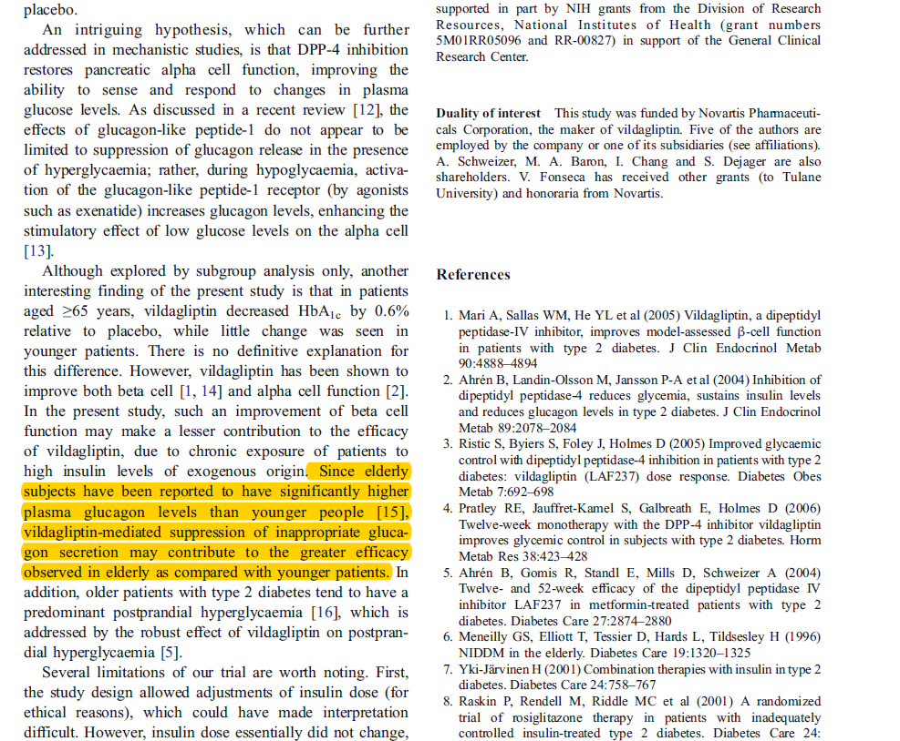

Slide 65



Glycaemic control in Renally impaired patients with T2DM

Slide 66
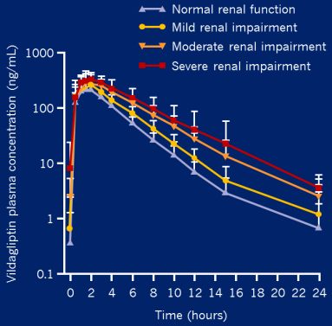
Basis for vildagliptin in T2DM patients with renal impairment
Only ~25% of vildagliptin is excreted unchanged by kidney
(main excretion mode is hydrolysis to inactive metabolite)
Geometric mean ratios (90% CI)
Parameter | Mild RI | Moderate RI | Severe RI
Vildagliptin
C_{max}, ng/mL | 1.37 (1.17, 1.60) | 1.32 (1.12, 1.55) | 1.36 (1.15, 1.61)
AUC_{t}, ng x h/mL | 1.40 (1.24, 1.57) | 1.71 (1.52, 1.93) | 2.00 (1.77, 2.26)
*
Minimal increase in vildagliptin exposure
No increase in C_{max,} up to 2 fold increase in exposure (AUC) in severe RI
50 mg b.i.d.
Effective increase in vildagliptin half life
50 mg o.d.
In patients with moderate-severe RI with vildagliptin:
Vildagliptin 50 mg o.d. expected to maintain 24-hour DPP-4 enzyme blockade
HbA1c reductions with 50 mg o.d. similar to reduction with 50 mg b.i.d. with preserved renal function & similar baseline A1c
Safety profile of vildagliptin 50 mg o.d. similar to that of placebo
Halving of dose frequency translates into cost benefits
*He et al. Int J Clin Pharmacol Ther. 2013;51:693-703; Lukashevich et al. Diabetes Obes Metab 2011;13:947–54; Schweizer A & Dejager S. Diabetes Ther 2013;4:257–67; Kothny et al, Diabetes Obesity Metab 2012;14:1032–9.
AUC=area under the curve; C_{max}=maximum concentration; CI=confidence interval

Slide 67
Vildagliptin Monotherapy: Overall AE Profile Comparable with Placebo (AEs >5%)
Pooled analysis at 24 weeks
Preferred term | Vilda 50 mg once daily N=655 n (%) | Vilda 50 mg twice daily N=2251 n (%) | Met >1000 mg twice daily N=252 n (%) | Rosi 8 mg once daily N=267 n (%) | Acar <100 mg thrice daily N=220 n (%) | Placebo N=586 n (%)
Nasopharyngitis | 37 (5.6) | 128 (5.7) | 13 (5.2) | 20 (7.5) | 14 (6.4) | 36 (6.1)
Headache | 35 (5.3) | 112 (5.0) | 13 (5.2) | 14 (5.2) | 1 (0.5) | 23 (3.9)
Dizziness | 29 (4.4) | 105 (4.7) | 10 (4.0) | 11 (4.1) | 9 (4.1) | 20 (3.4)
Upper respiratory tract infection | 11 (1.7) | 75 (3.3) | 5 (2.0) | 8 (3.0) | 11 (5.0) | 20 (3.4)
Diarrhea | 10 (1.5) | 64 (2.8) | 57 (22.6) | 7 (2.6) | 6 (2.7) | 12 (2.0)
Nausea | 10 (1.5) | 53 (2.4) | 23 (9.1) | 2 (0.7) | 0 | 13 (2.2)
Acar=acarbose; AE=adverse event; met=metformin; rosi=rosiglitazone; vilda=vildagliptin
Preferred terms are sorted by descending order of incidence in the vildagliptin 50 mg twice-daily group.
A patient with multiple AE occurrences on one treatment is counted once in the AE category for that treatment.
Adapted from Summary of Clinical Safety, December 5, 2007. Table 4-1g. Novartis Pharmaceuticals.
Notes:
Vildagliptin Monotherapy: Overall AE Profile Comparable with Placebo
(AEs >5%)
Data from comparative trials of vildagliptin monotherapy (50 mg once daily or
50 twice daily) and metformin, rosiglitazone, acarbose, or placebo were pooled to evaluate the adverse-event (AE) profile of vildagliptin at 24 weeks.
AEs that occurred in at least 5% of patients in any group are presented.
The overall incidence of AEs was highest in rosiglitazone-treated patients (65%). The incidence in patients treated with vildagliptin (50 mg once daily, 58%;
50 mg twice daily, 54%) was similar to the 58% incidence reported by the placebo group.
These data indicate that vildagliptin is a well-tolerated agent, with an AE profile that is comparable with placebo.
Reference
Adapted from Summary of Clinical Safety, December 5, 2007. Table 4-1g. Novartis Pharmaceuticals.

Slide 68
SUMMARY
From a baseline HbA1c of 8.4%, Galvus gives as much as 1.1% reduction in HbA1c in patients on Metformin monotherapy not at goal
Galvus® Met gives up to 3.44% reduction in HbA1c in T2DM patients uncontrolled on Metformin with HBA1c above 10% (EDGE trial).
Galvus® Met gives 3.2% reduction in HbA1c in newly diagnosed T2DM patients with HBA1c above 10%.
Galvus is the only DPP-4I that delivers > 1% HbA1c reduction from a baseline of 8.4% in patients not at goal with Metformin monotherapy.
Galvus, but not SU delivers consistent efficacy versus SUs in both RCT and the Real World with a superior tolerability profile (incidence of hypoglycaemia and weight gain) over SUs.
SU- Sulphonyl Urea; RCT-randomized controlled trial

Slide 69
SUMMARY CONTD’
Galvus decreases HBA1c to 0.8% from baseline of 8.8% in T2DM patients uncontrolled on high doses of insulin therapy.
There is no significant increase in hypoglycaemia or weight in patients on insulin + Galvus
Lower doses of insulin is needed to achieve glycaemic control in Galvus add on to insulin patients unlike those on insulin monotherapy
In Moderate, severe and ESRD T2DM patients, Galvus delivers up to 0.92% HbA1c reduction from a baseline of 7.8%.
Galvus allows for about 50% cost saving versus other branded DPP-4 I’s

